Slide 1
Investigator
Co-Pilot
From raw evidence to verified case intelligence
CPIB | Oct 2026

Slide 2
Investigators cross-check fragmented evidence manually
The Investigation Challenge
Many formats
Many languages
Hidden links
Missed contradictions
WhatsApp chats, statements, documents and audio sit in separate files
Recordings and messages mix English, Malay and Chinese
Connecting people, companies and money flows means reading everything
Conflicting figures across statements are easy to overlook

Slide 3
Four Capabilities set the Co-Pilot apart
01
Graph-based retrieval
02
Cross-statement analysis
Not just semantic search but Graph-RAG surfaces multi-hop links between people, companies and transactions flows
Aligns facts across witnesses and flags contradicting statements
03
Multilingual speech-to-text
04
Verified, human-led output
Transcribes English, Malay and Chinese and identifies speakers by voice
Citations on every answer; investigators approve every entity merge.

Slide 4
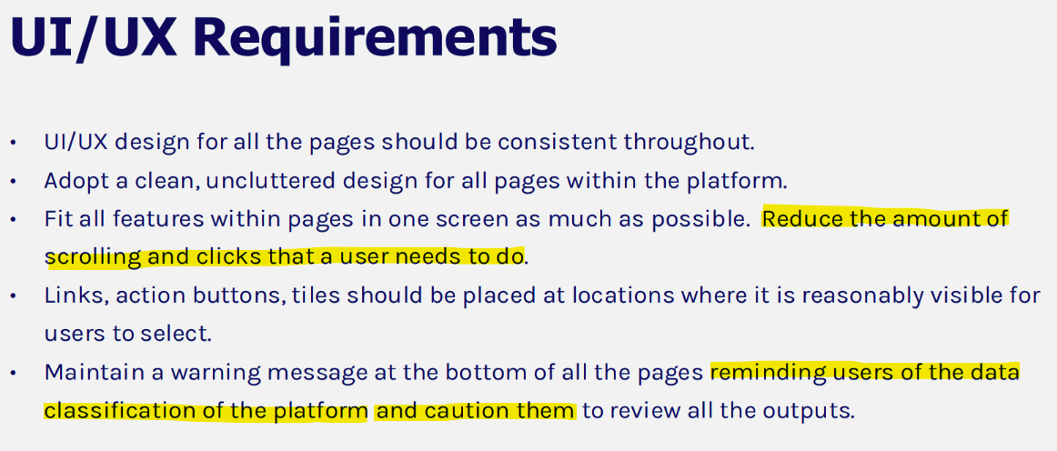
User Experience – Improve Product Adoption
User experience differentiators
Unified Workbench : Officer can review those cases and start investigation from single dashboard.
Intuitive views : explore entity links in the graph. A planned timeline adds chronological context.
Easy to use : guided Steps and Prompts, sample questions and a short case walkthrough help officers complete their first evidence review
Continuity across sessions :Save searches, filters and case views so officers can resume work without repeating setup.
Support different personas:
          Operational officers: guided case tasks without technical knowledge.
          Forensic officers: trace source evidence and inspect entity links.
(from CPIB)

Slide 5
Graph Based Investigation (POLE Data Model)
P = People , O = Object/Evidence, L = Location and E = Event
Investigator asks: “How is Vendor X connected to Officer A?”
Evidence Timeline :
Knowledge Graph relationship view
09:14
Meeting arranged with Vendor X
Witness
Vendor X
11:42
Payment reference appears in chat
Officer A
14:05
Witness statement names same contact
16:30
Audio transcript confirms location
Location
Payment
Highlight: cross-document and cross-conversation correlation can reveal corroboration, inconsistencies and relationships that are difficult to detect in a linear review.
Notes:
[Sources]
- <File>GCC plus migration_BQ Comms Deck_Vendor v1.1.pdf</File>, pages 4, 6 and 10; <File>Qualification - 20260702-SF008518 - CPIB - CPIB GEN AI ROADMAP - BQ.pptx</File>, slide 9
[/Sources]

Slide 6

Investigation Journey - Workflow
1
2
3
Verify The Facts
4
Start The Case
Prepare The Conclusion
Investigate The Case
- Case status and progress.
- Upload chats and statements to build the case graph.
Verify citations, entities and statements with Fact Audits
Ask investigation questions and Trace evidence links with graph and keyword search.
Review cited facts with the Case Supervisor.

Slide 7
Live demo
One case, from evidence upload to case conclusion

Slide 8
Demo Flow – Bribery Scenario
Scenario:
AI-assisted investigation involved different parties for High Value goods purchase between Procurement, Finance and Third-party supplier .
Persona:
Investigation Officer / Case Supervisor reviewing evidence, relationships and case progress
1
Start the case
Open the isolated Evidence Box workspace. Upload chats, statements and media; Builds a case knowledge graph from the evidence.
Investigate the case
Ask how people, companies or events connect. Graph and keyword search surface links; inspect the graph and open cited source material. Timeline visualization is supported for chronological analysis of events
2
Verify the facts
Check citations against the evidence. Validate or merge entity matches in Fact Audit, then compare statements for agreement and discrepancies.
3
Prepare the conclusion
Review a cited summary of supported facts and open discrepancies with the Case Supervisor. Close with multilingual transcription and officer review.
4

Slide 9
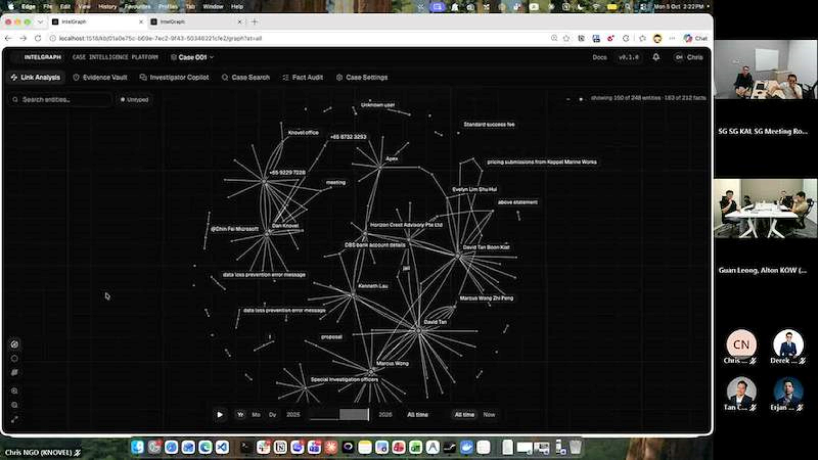
Demo Video#1
Knovel OKIQ Demo Planning to CPIB-20261005_140431-Meeting Recording.mp4

Slide 10
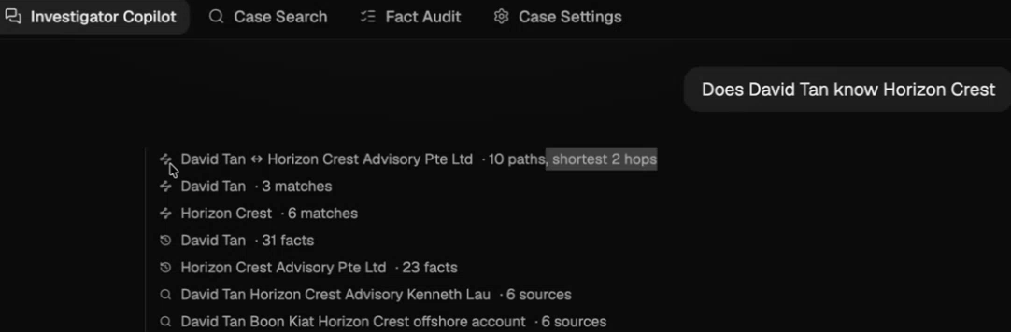
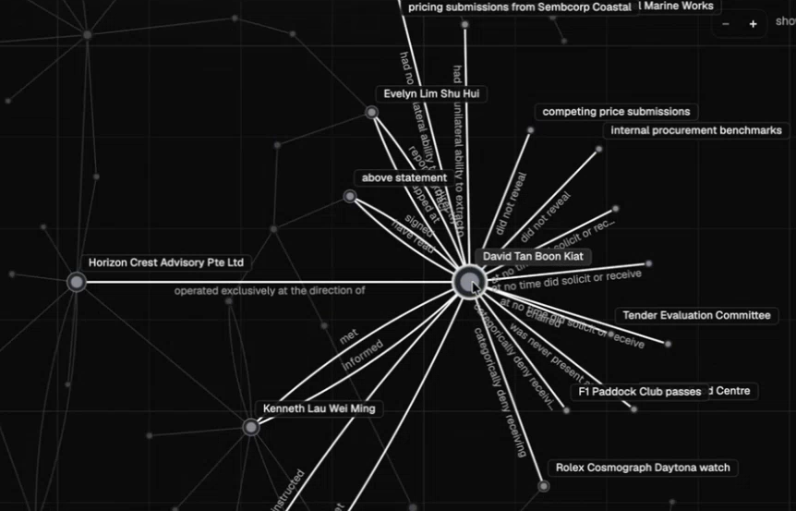
Explore The Hidden Connection

Slide 11
Scenario: Investigation of case evidence from WhatsApp chats, witness/accused statements, and multimedia evidence using an AI investigator co-pilot platform
Persona: Investigation Officer / Case Supervisor reviewing evidence, relationships, and case progress
1. Go to Workbench
Access “Evidence Box / Investigator Co-pilot” workspace where all case files are uploaded and isolated per case
2. Check the data to use
Upload and ingest WhatsApp chats, witness/accused statements, and other evidence into the system for processing
Data is structured into a knowledge graph from unstructured inputs
3. Investigate using Chatbot
Use AI chatbot powered by graph search + keyword + past interactions to analyze relationships and cases
System summarizes findings such as connections between suspects and companies in the case
4. Check and verify the citation
AI-generated findings include clickable citations for fact-checking and verification by officers
Fact audit allows human validation or merging of suggested entity matches (AI suggests, humans approve)
5. Look at the graph, timeline
Knowledge graph shows relationships between people, companies, and events extracted from chats and statements
Timeline visualization is supported for chronological analysis of events
6. Do case-conclusion with evidence
System produces summaries of aligned facts and discrepancies across multiple statements and witnesses
Outputs structured analysis including contradictions and corroborations across evidence sources
7. Highlight USP and productivity gain
Graph-based RAG over unstructured legal/investigation data for relationship discovery
AI-assisted cross-statement comparison to detect discrepancies and corroboration
Multilingual speech-to-text and entity identification across languages (Malay, Chinese, English, etc.)
Human-in-the-loop fact audit ensures controlled and verifiable investigation outputs
Demo Flow - Details

Slide 12
Demo Feedback – Govware with CPIB
Tracy asked for overall timeline including build OKIQ solution with security testing, she expected no more than 10mths.
Frankie highlighted multi personas or profiles to use the solution e.g procurement team, policy & compliance team.
Tracy and Frankie asked for the integration with Copilot or Agent 2.0, where those front-end Agent/plugins can query or search those docs/evidences through API backend to OKIQ.
Tracy asked for access control on the database only can be used based on each user dept/role (RBAC)
Frankie shared the issue with existing Agent 2.0 case mgmt system, that not able to do searching through the contents or keyword inside uploaded docs.

Slide 13
Other Similar System - Comparison
KASEWARE
COMTRAC
POLONIOUS
Unified investigative intelligence
Evidence-to-offence discipline
Configurable workflow operations
• Secure, collaborative platform from intake to closure
• Built-in link analysis and geospatial mapping
• Interagency sharing and configurable access controls
It built for a federal agency working open-world threat cases
Its analytic edge is open-source collection, which does little for closed-world corruption casework.
• Elementising Evidence™ maps exhibits to offence or breach elements
• Targeted AI supports evidence analysis with human review
• One-click reports and court-ready briefs
Its AI is pre-configured prompts over structured case fields — document assembly, not cross-document reasoning.
No feature for chat forensics, no contradiction detection across statements.
• Flexible workflows with gated decision points
• Workload allocation, scheduling and linked-case hierarchy
• Automated reporting and BI visibility
Built for insurance and workplace investigations. It administers cases rather than analysing evidence
No link analysis, no element mapping, no AI layer.
Best for intelligence-led work
Best for proof-led work
Best for process-led work
Kaseware demo video: https://youtu.be/DfiarWyD-TI?si=vKA9i4KJz9YeCOAA&t=2560

Slide 14
Meeting with Knovel
12-Oct-2026
Agree to have User Journey on Bribery case
To provide product features on Timelines and Dashboards

Slide 16
Next steps
This need to be targeted for follow-up demo
Owner
1
Agree the pilot case
Choose one closed case and a sanitised evidence set
TBC
2
Set success measures
For example, review hours per case and contradictions found
TBC
3
Confirm hosting and security
Data residency, access control and audit requirements
TBC
4
Run a hands-on session
CPIB investigators try the Co-Pilot on the pilot case
TBC

Slide 17
The Co-Pilot turns raw evidence into a case graph
Evidence box
Knowledge graph
Hybrid search + AI
Cited answers
Upload chats, statements, files and audio per case
Extracts people, companies, events and how they connect
Graph traversal and keyword search feed the case AI agent
Every finding links back to the source evidence
Modules that work on the same case graph
Statement Analysis
Fact Audit
Speech-to-text
Per-person summaries and flagged discrepancies
AI suggests merges; investigators decide
English, Malay and Chinese, with speaker ID

Slide 18
Every answer combines graph links with keyword search
Investigator asks: “How is Person A connected to Company X?”
Graph search
Traverses relationships, e.g. 2-hop links between people and companies
Case AI agent
Combines both result sets, for this case only
Cited answer
Person A is a director of Company Y¹, which paid Company X RM 50,000²
Investigators click ¹ or ² to open the source chat or statement
Keyword search
BM25 finds exact names, amounts and phrases in the raw text

Slide 19
The demo follows one case from upload to conclusion
Step | What to show | Point to make | Time
1 Open case, upload | Drop a WhatsApp export, a document and a statement into the evidence box | Each case is isolated | 2 min
2 Explore the graph | Extracted people, companies and accounts; follow one suspect | Structure from raw text | 3 min
3 Ask and verify | Ask how Person A links to Company X, then click a citation | Every answer is traceable | 4 min
4 Add evidence | Upload one more item and watch new nodes join the graph | The graph grows, no rebuild | 2 min
5 Fact Audit | Approve one suggested merge and reject a false one | The investigator decides | 2 min
6 Statement Analysis | Compare witness and accused accounts; show the conflicting RM figure | Contradictions surface fast | 4 min
7 Multilingual audio | Play a mixed Malay, English and Chinese clip with speakers identified | Audio joins the same case | 3 min

Slide 20
Timeline, dashboards and cross-case links come next
Shown in the demo
Planned next
Knowledge graph built per case
Timeline view of investigation events
Graph + keyword search with citations
Supervisor dashboard of officer progress and case status
Statement Analysis and discrepancy flags
Cross-case comparison and linking, under access controls
Fact Audit with investigator approval
Multilingual speech-to-text, speaker ID

